Slide 1
Capstone Project: Find the best place to open a gym in Bogotá, Colombia

Slide 2
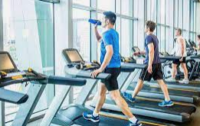
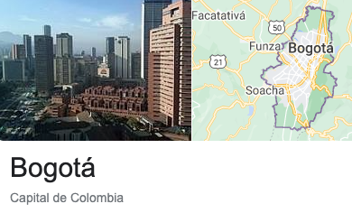
Bogotá is the capital of Colombia, a country with an expected GDP growth of 7% by 2021, with a young population that has become aware of the importance of healthy lifestyles in the midst of economic growth.

Slide 3
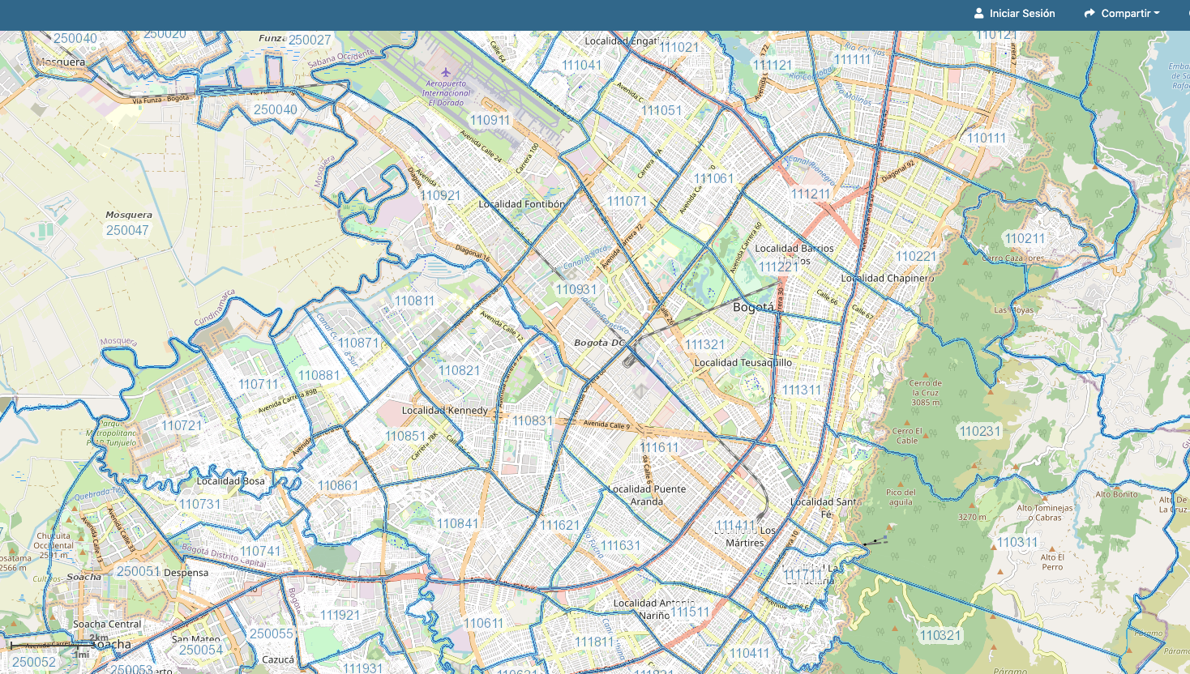

Slide 4
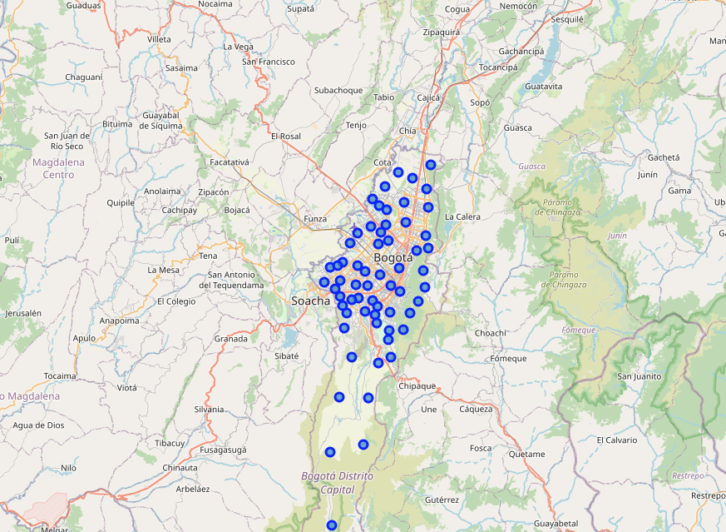

Slide 5
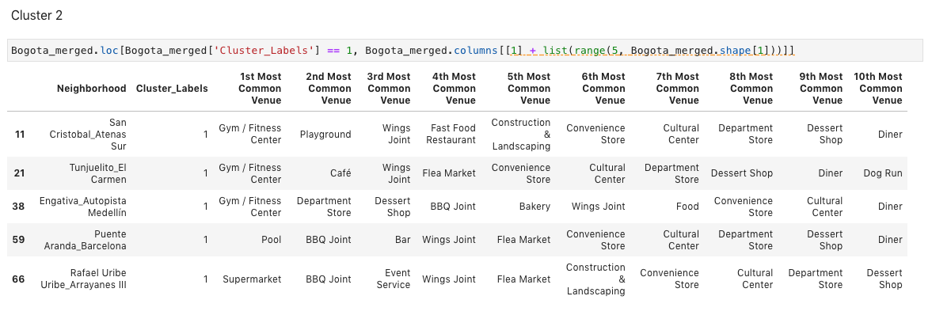
Conclusion: Cluster 2 (blue light)!

Slide 6
